Slide 1
Figures – Chapter 4

Slide 2
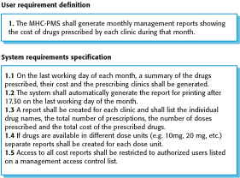
Figure 4.1 User and system requirements

Slide 3
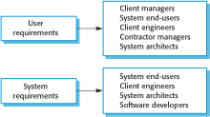
Figure 4.2 Readers of different types of requirements specification

Slide 4
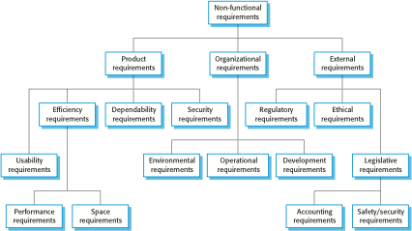
Figure 4.3 Types of nonfunctional requirement

Slide 5
Figure 4.4 Examples of nonfunctional requirements in the MHC-PMS
Product requirement The MHC-PMS shall be available to all clinics during normal working hours (Mon–Fri, 0830–17.30). Downtime within normal working hours shall not exceed five seconds in any one day. Organizational requirement Users of the MHC-PMS system shall authenticate themselves using their health authority identity card. External requirement The system shall implement patient privacy provisions as set out in HStan-03-2006-priv.

Slide 6
Figure 4.5 Metrics for specifying nonfunctional requirements
Property | Measure
Speed | Processed transactions/second User/event response time Screen refresh time
Size | Mbytes Number of ROM chips
Ease of use | Training time Number of help frames
Reliability | Mean time to failure Probability of unavailability Rate of failure occurrence Availability
Robustness | Time to restart after failure Percentage of events causing failure Probability of data corruption on failure
Portability | Percentage of target dependent statements Number of target systems

Slide 7
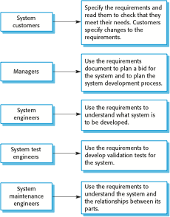
Figure 4.6 Users of a requirements document

Slide 8
Figure 4.7 The structure of a requirements document
Chapter | Description
Preface | This should define the expected readership of the document and describe its version history, including a rationale for the creation of a new version and a summary of the changes made in each version.
Introduction | This should describe the need for the system. It should briefly describe the system’s functions and explain how it will work with other systems. It should also describe how the system fits into the overall business or strategic objectives of the organization commissioning the software.
Glossary | This should define the technical terms used in the document. You should not make assumptions about the experience or expertise of the reader.
User requirements definition | Here, you describe the services provided for the user. The nonfunctional system requirements should also be described in this section. This description may use natural language, diagrams, or other notations that are understandable to customers. Product and process standards that must be followed should be specified.
System architecture | This chapter should present a high-level overview of the anticipated system architecture, showing the distribution of functions across system modules. Architectural components that are reused should be highlighted.
System requirements specification | This should describe the functional and nonfunctional requirements in more detail. If necessary, further detail may also be added to the nonfunctional requirements. Interfaces to other systems may be defined.
System models | This might include graphical system models showing the relationships between the system components and the system and its environment. Examples of possible models are object models, data-flow models, or semantic data models.
System evolution | This should describe the fundamental assumptions on which the system is based, and any anticipated changes due to hardware evolution, changing user needs, and so on. This section is useful for system designers as it may help them avoid design decisions that would constrain likely future changes to the system.
Appendices | These should provide detailed, specific information that is related to the application being developed; for example, hardware and database descriptions. Hardware requirements define the minimal and optimal configurations for the system. Database requirements define the logical organization of the data used by the system and the relationships between data.
Index | Several indexes to the document may be included. As well as a normal alphabetic index, there may be an index of diagrams, an index of functions, and so on.

Slide 9
Figure 4.8 Ways of writing a system requirements specification
Notation | Description
Natural language | The requirements are written using numbered sentences in natural language. Each sentence should express one requirement.
Structured natural language | The requirements are written in natural language on a standard form or template. Each field provides information about an aspect of the requirement.
Design description languages | This approach uses a language like a programming language, but with more abstract features to specify the requirements by defining an operational model of the system. This approach is now rarely used although it can be useful for interface specifications.
Graphical notations | Graphical models, supplemented by text annotations, are used to define the functional requirements for the system; UML use case and sequence diagrams are commonly used.
Mathematical specifications | These notations are based on mathematical concepts such as finite-state machines or sets. Although these unambiguous specifications can reduce the ambiguity in a requirements document, most customers don’t understand a formal specification. They cannot check that it represents what they want and are reluctant to accept it as a system contract

Slide 10
Figure 4.9 Example requirements for the insulin pump software system
3.2 The system shall measure the blood sugar and deliver insulin, if required, every 10 minutes. (Changes in blood sugar are relatively slow so more frequent measurement is unnecessary; less frequent measurement could lead to unnecessarily high sugar levels.) 3.6 The system shall run a self-test routine every minute with the conditions to be tested and the associated actions defined in Table 1. (A self-test routine can discover hardware and software problems and alert the user to the fact the normal operation may be impossible.)

Slide 11
Figure 4.10 A structured specification of a requirement for an insulin pump

Slide 12
Figure 4.11 Tabular specification of computation for an insulin pump
Condition | Action
Sugar level falling (r2 < r1) | CompDose = 0
Sugar level stable (r2 = r1) | CompDose = 0
Sugar level increasing and rate of increase decreasing ((r2 – r1) < (r1 – r0)) | CompDose = 0
Sugar level increasing and rate of increase stable or increasing ((r2 – r1) ≥ (r1 – r0)) | CompDose = round ((r2 – r1)/4) If rounded result = 0 then CompDose = MinimumDose

Slide 13
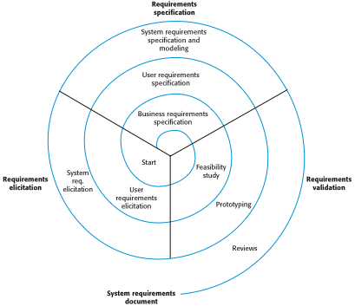
Figure 4.12 A spiral view of the requirements engineering process

Slide 14
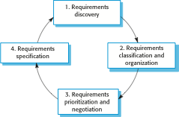
Figure 4.13 The requirements elicitation and analysis process

Slide 15
Figure 4.14 Scenario for collecting medical history in MHC-PMS

Slide 16
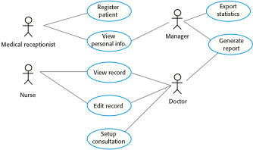
Figure 4.15 Use cases for the MHC-PMS

Slide 17

Figure 4.16 Ethnography and prototyping for requirements analysis

Slide 18
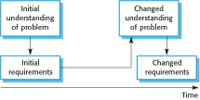
Figure 4.17 Requirements evolution

Slide 19

Figure 4.18 Requirements change management

